Slide 1
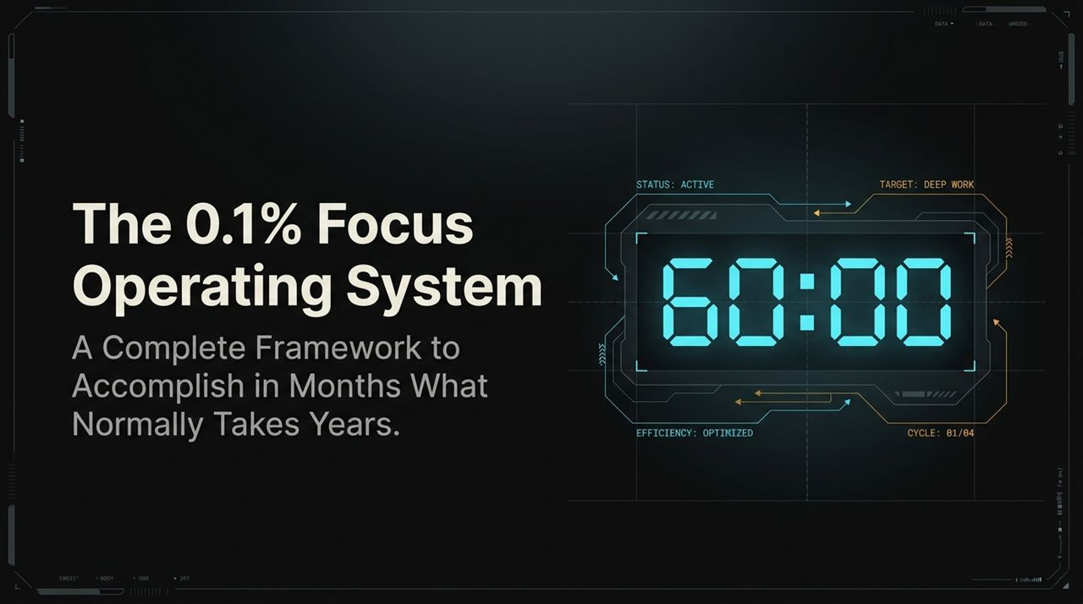
Notes:
Welcome, everyone. Today, we’re unpacking a system designed for high performers, entrepreneurs, and anyone ambitious enough to care about achieving their absolute maximum potential.
Notice the title: The 0.1% Focus Operating System. We aren't here to talk about minor 5% productivity tweaks, 60-second life hacks, or generic advice.
The core premise of this operating system is simple: if you can systematically eliminate friction, block external distractions, and master daily deep work blocks, you can collapse time frames. What takes an average individual or company two years to accomplish, you can achieve in mere months.
Think of this presentation as a complete blueprint. By the end of this session, you won't rely on raw willpower or fleeting motivation; you will have a functional, engineered system to dictate your output every single day.
https://www.youtube.com/watch?v=l7RmB3LQd4w

Slide 2
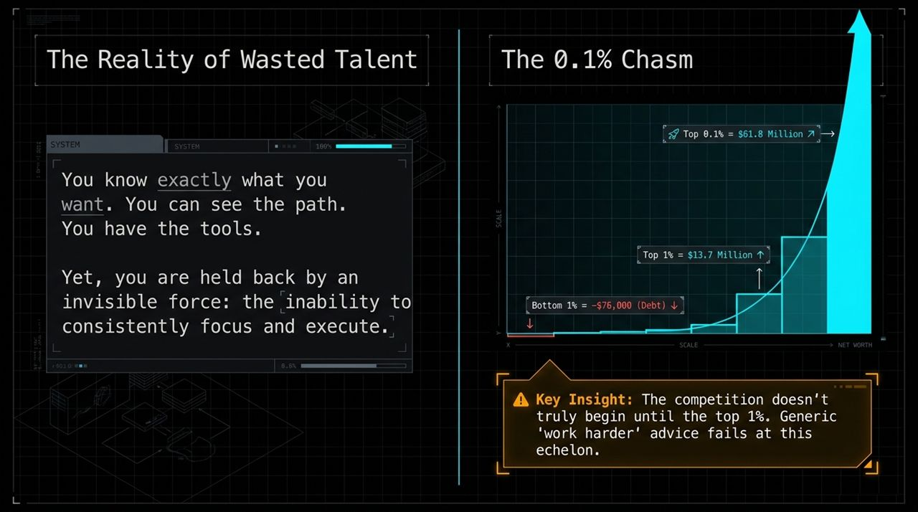
Notes:
Let's begin with a uncomfortable truth: talent and ambition alone mean almost nothing without consistent execution.
Look at the visual on this slide. Most people assume the gap between average performance and elite performance is linear. It isn't. The difference between the Top 1% and the Top 0.1% is an exponential chasm.
While reaching the top 1% requires skill and dedication, jumping into the top 0.1% requires a complete shift in how you operate. At this level, telling yourself or your team to 'just work harder' or 'try harder' completely fails.
The real bottleneck isn't a lack of information or lack of desire. You know what your goals are. The real issue is the invisible force holding you back: an inability to maintain relentless, unbroken focus day after day.

Slide 3
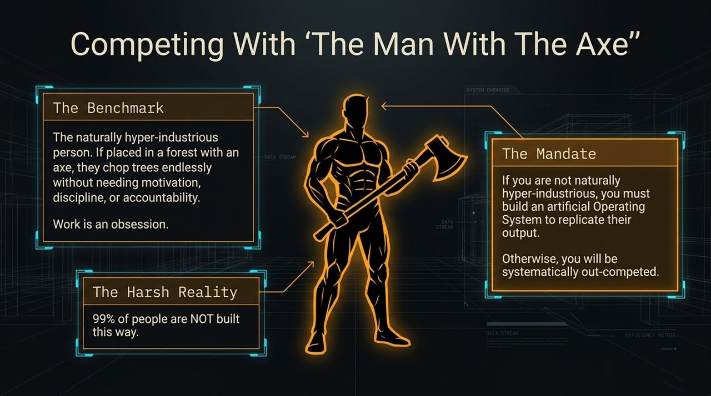
Notes:
To understand why we need an operating system, we have to look at our benchmark competitor: 'The Man with the Axe'.
Imagine a person who is naturally hyper-industrious. You put them in a dense forest with an axe, and they will chop down trees for 12 hours straight without stopping.
They don't need a motivational video. They don't need an accountability buddy, a morning coffee ritual, or a pep talk. Work is their obsession.
Now here is the harsh reality: 99% of human beings are simply not hardwired this way. We experience resistance, fatigue, procrastination, and distraction.
If you aren't naturally built like the Man with the Axe, you have two choices: accept being out-competed, or construct an artificial Operating System that forces your brain and environment to replicate that level of output.

Slide 4
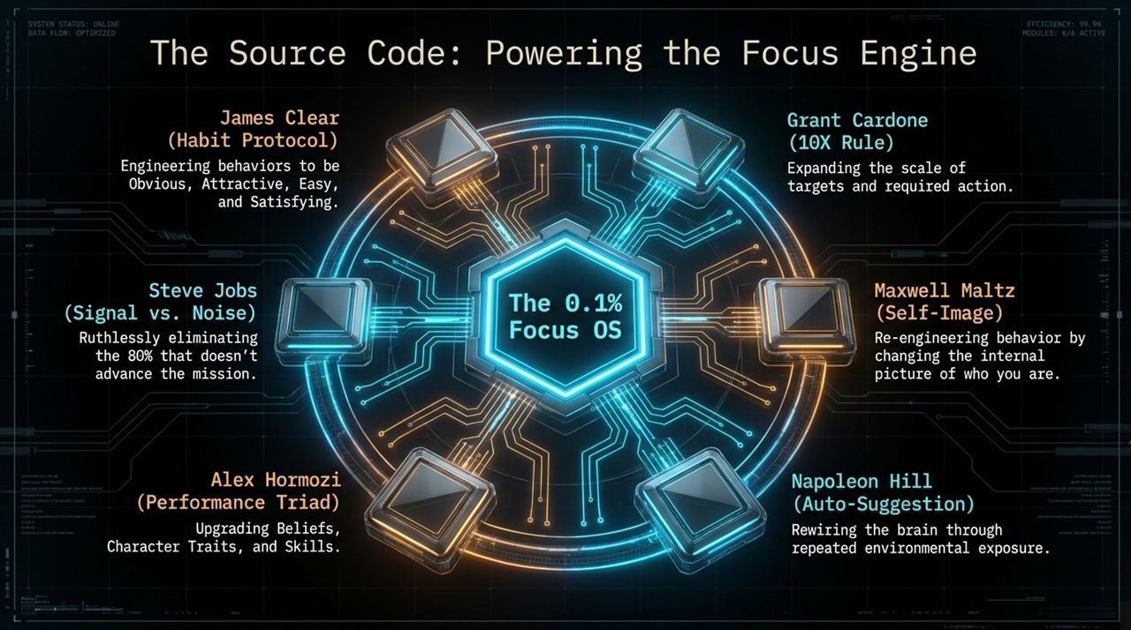
Notes:
This Focus OS was not invented in a vacuum. It synthesizes proven methodologies from master practitioners across habit engineering, mindset, and ruthless execution.
We pull from James Clear to structure habits so they are obvious, attractive, easy, and satisfying.
We pull from Steve Jobs for the principle of Signal vs. Noise— ruthlessly cutting out the bottom 80% of tasks that don't directly move the needle.
We integrate Grant Cardone’s 10X targets, Alex Hormozi’s triad of beliefs, traits, and skills, Maxwell Maltz’s self-image psychology, and Napoleon Hill’s auto-suggestion tactics.
Combined, these components form the underlying source code of our Focus OS.

Slide 5
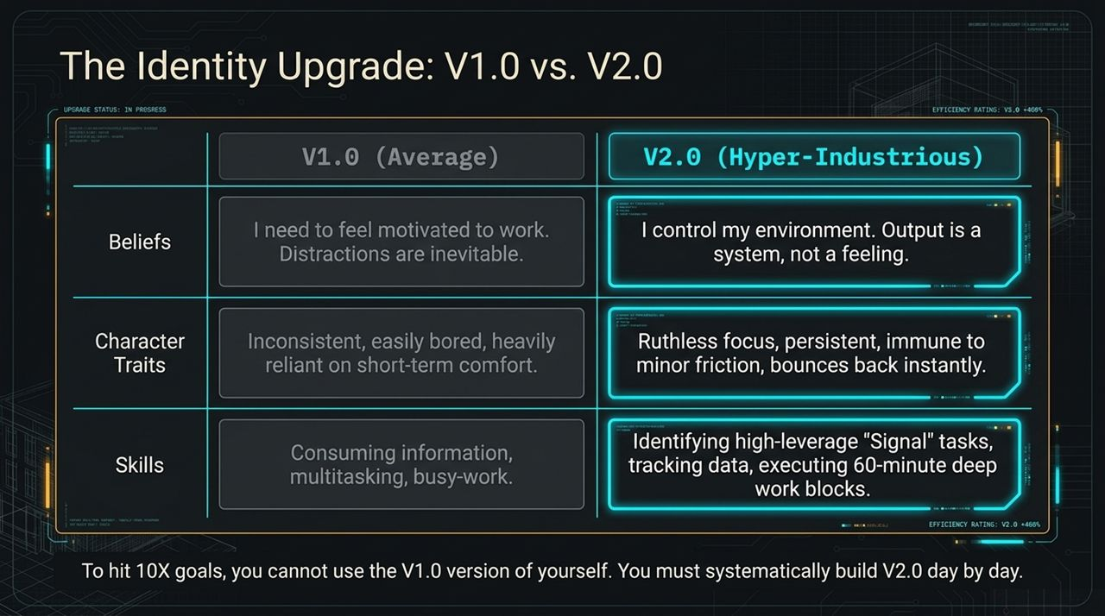
Notes:
You cannot achieve 10X scale goals using the V1.0 version of yourself. To get 10X results, your operating identity must be upgraded to V2.0.
Let's compare the two across three core pillars: Beliefs, Character Traits, and Skills.
Beliefs: V1.0 believes 'I need to feel motivated to work.' V2.0 knows that motivation is irrelevant; output is purely a engineered system.
Character Traits: V1.0 is easily bored, inconsistent, and reliant on comfort. V2.0 demonstrates ruthless focus, persistence, and instant recovery from minor friction.
Skills: V1.0 spends energy on multitasking, consumption, and low-leverage busywork. V2.0 masters identifying high-leverage 'Signal' tasks and executing 60-minute deep work blocks.

Slide 6
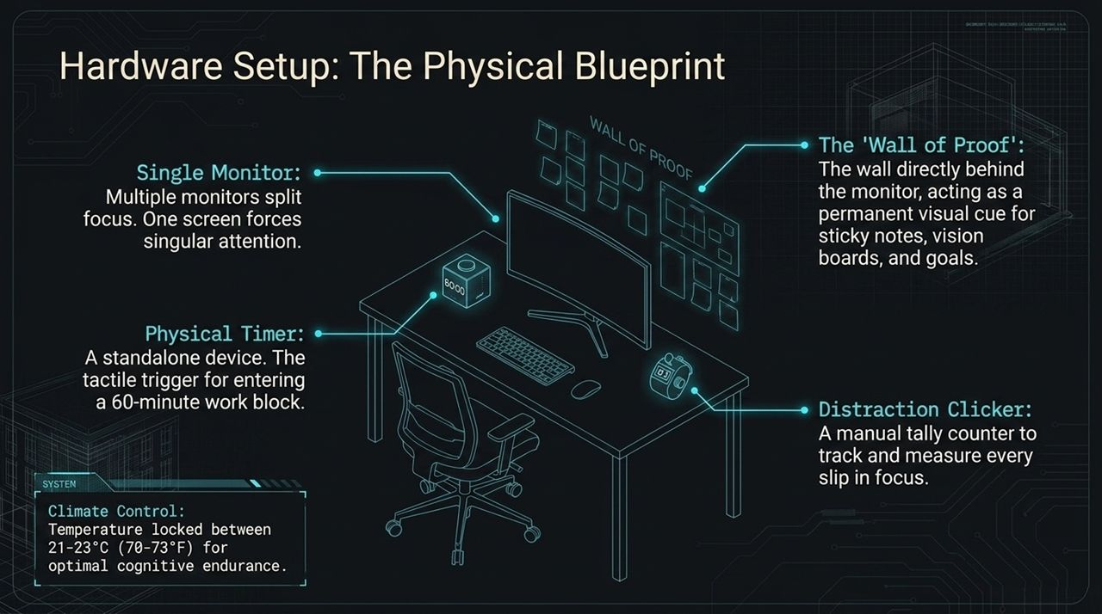
Notes:
Environment will always triumph over willpower. If your physical workspace is flawed, your focus will fail.
First, a single monitor. Multiple monitors split cognitive attention; one screen forces singular focus.
Second, a physical timer sitting right beside your keyboard. It serves as a tactile, unambiguous trigger when entering a work block.
Third, the Distraction Clicker—a manual tally counter to log every time your mind wanders or you attempt to check a secondary tab.
Fourth, climate control set rigidly between 21–23°C (70–73°F) to maintain optimal alertness, combined with a visual Wall of Proof directly behind your monitor.

Slide 7
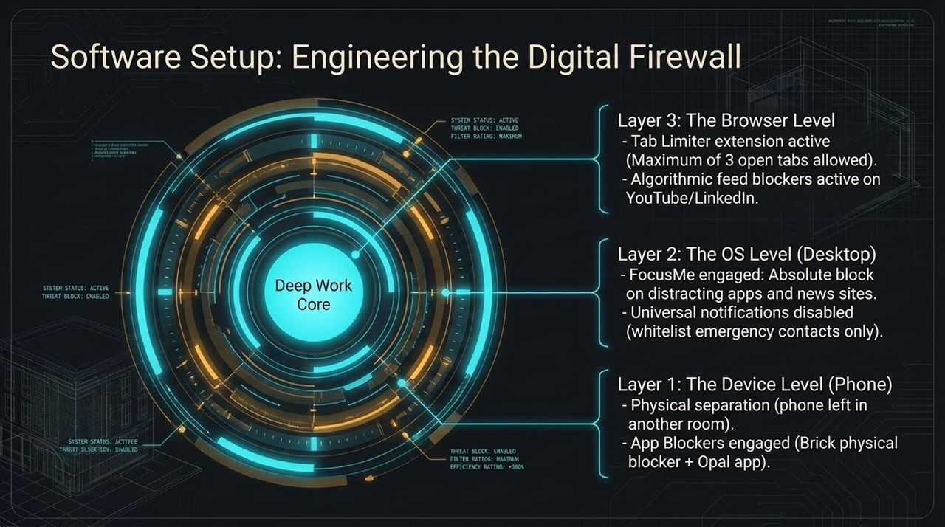
Notes:
Physical setup is half the battle; the digital environment is where most modern knowledge workers fall apart. We implement a strict 3-layer digital firewall.
Layer 1 (Device Level): Physical separation of the smartphone. Put it in another room. Combine this with physical hardware blockers like Brick or apps like Opal.
Layer 2 (OS Level): Software like FocusMe engaged on your desktop. It hard-blocks distracting applications and news portals, disabling all notifications except whitelisted emergency contacts.
Layer 3 (Browser Level): Use a tab-limiter extension set to a hard maximum of 3 open tabs, along with feed blockers on sites like YouTube or LinkedIn.

Slide 8
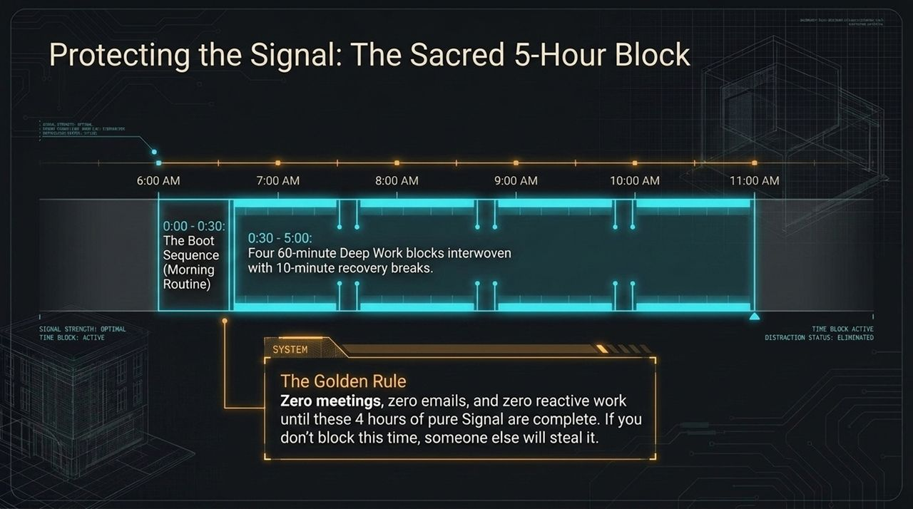
Notes:
This is the core architecture of your workday: The Sacred 5-Hour Block.
It begins with a 30-minute 'Boot Sequence' (morning routine), followed by four 60-minute deep work blocks separated by 10-minute recovery breaks.
Now, memorize The Golden Rule: Zero meetings, zero emails, and zero reactive work until these 4 hours of pure Signal are complete.
If you do not proactively block this time on your calendar, the world around you will steal it.

Slide 9
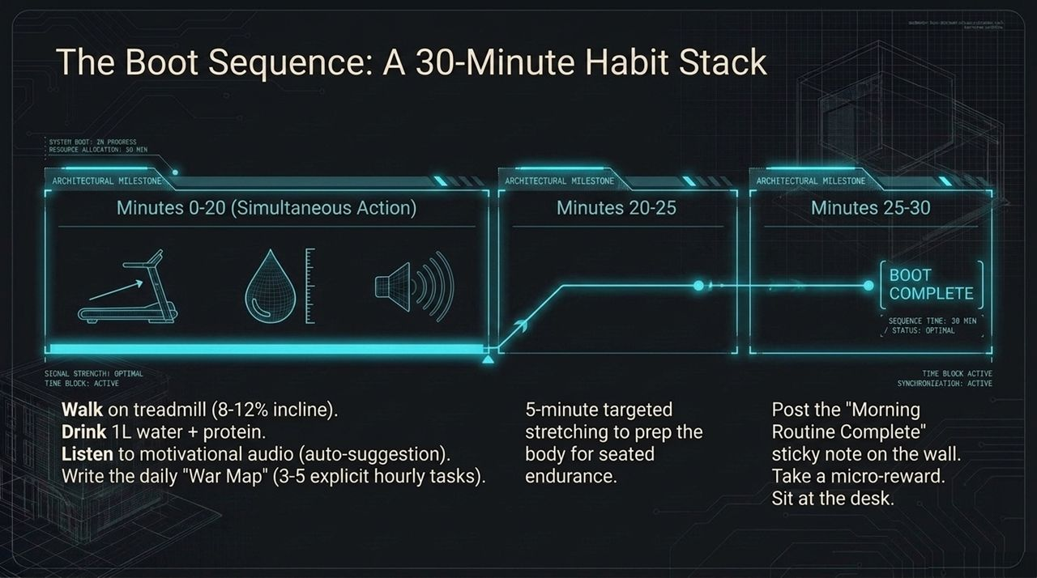
Notes:
How you start the morning dictates the trajectory of your entire day. Instead of randomly waking up and checking emails, you execute an engineered 30-minute Boot Sequence.
Minutes 0–20: Incline walk on a treadmill while hydrating with 1L of water and listening to auto-suggestion audio.
Minutes 20–25: Write your 'War Map'—identifying the exact 3 to 5 hourly tasks you will complete today.
Minutes 25–30: Targeted stretching to prepare your body for long periods of focus, followed by sitting at your desk to trigger the first block.

Slide 10
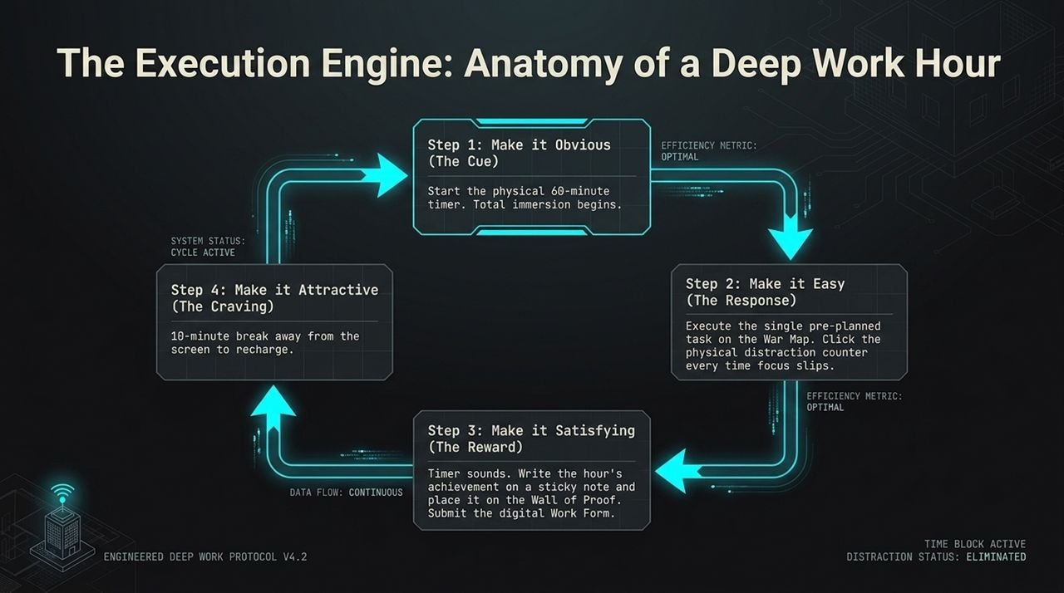
Notes:
Once seated, you execute individual 60-minute sprints structured around James Clear's 4 Laws of Behavior Change.
Step 1 (Cue): Press start on the physical 60-minute timer.
Step 2 (Response): Execute only the single pre-planned task on your War Map. Click the physical counter every time your mind wanders.
Step 3 (Reward): When the timer rings, write your completed hourly output on a sticky note and stick it to your Wall of Proof.
Step 4 (Craving/Break): Step away from all screens for a 10-minute break to reset your mind.

Slide 11
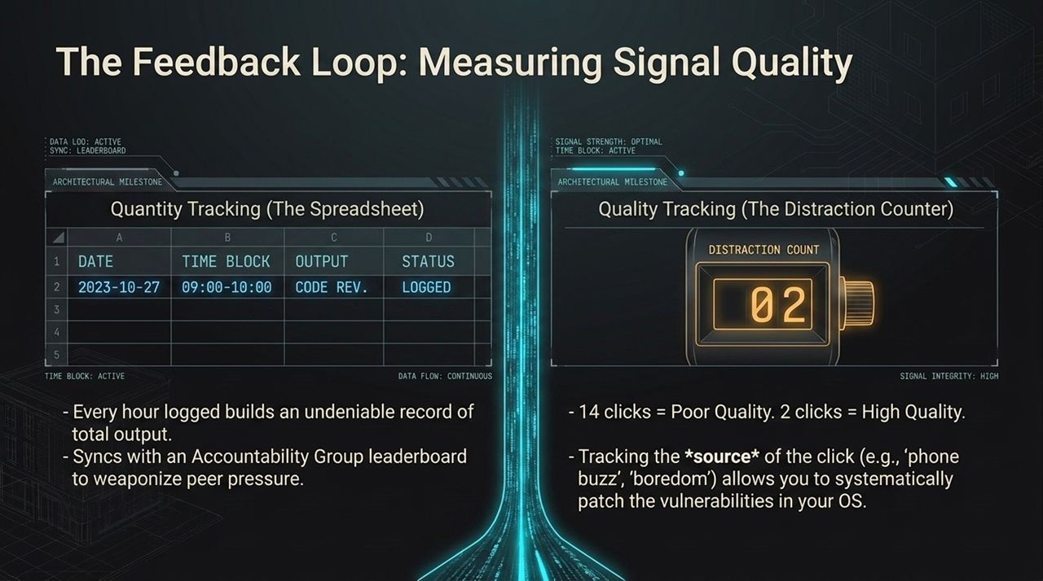
Notes:
What gets measured gets managed. To ensure quality remains high, we measure both Quantity and Quality.
Quantity Tracking: Every hour logged is recorded in a tracking spreadsheet and shared with an accountability group or leaderboard.
Quality Tracking: Your distraction clicker provides direct feedback. 14 clicks in an hour means low focus; 2 clicks means high signal integrity.
By tracking the triggers of those clicks (e.g., boredom, phone buzzes), you can patch security holes in your operating system.

Slide 12
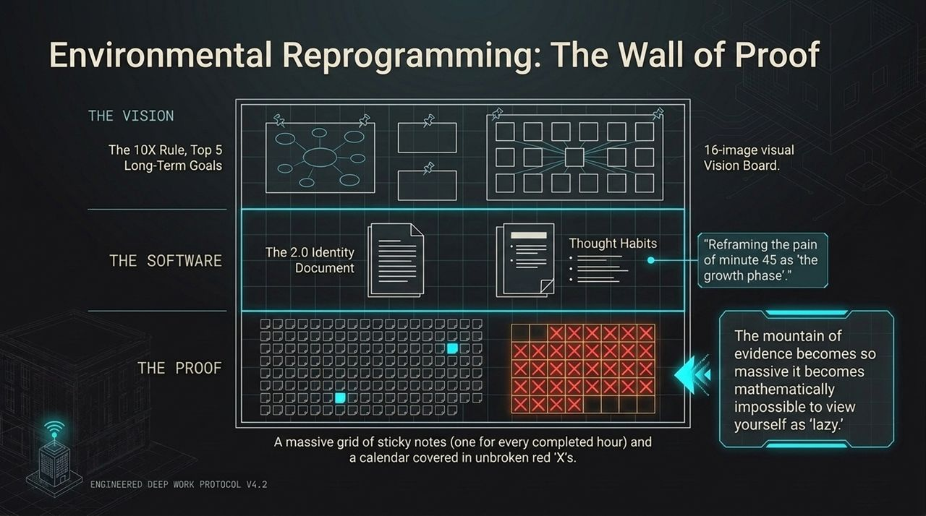
Notes:
The Wall of Proof serves as an undeniable visual feedback mechanism.
It combines The Vision (your 10X goals and visual board), The Software (your V2.0 identity document), and The Proof (a massive grid of sticky notes and unbroken calendar streaks).
When you look up from your screen and see hundreds of sticky notes representing hours of deep work, it becomes mathematically impossible to view yourself as lazy or undisciplined.

Slide 13
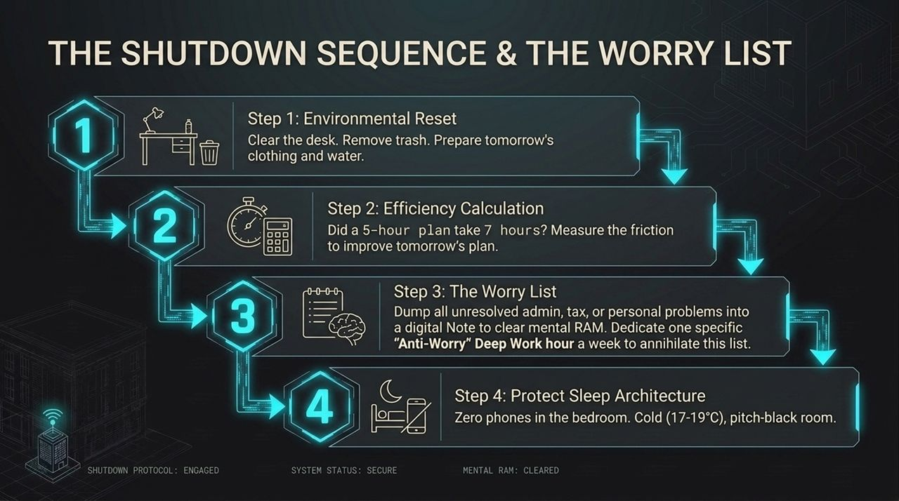
Notes:
A powerful morning requires a clean, structured evening shutdown.
Step 1: Reset your environment—clear the desk, toss trash, and prepare tomorrow's clothes.
Step 2: Calculate execution efficiency. Did a planned 5-hour task take 7 hours? Figure out why.
Step 3: The 'Worry List'—dump all unresolved thoughts, tasks, and tax/admin stress into a digital note to clear your mental RAM.
Step 4: Protect sleep—phones outside the room, cold temperature (17–19°C), and a pitch-black environment.

Slide 14
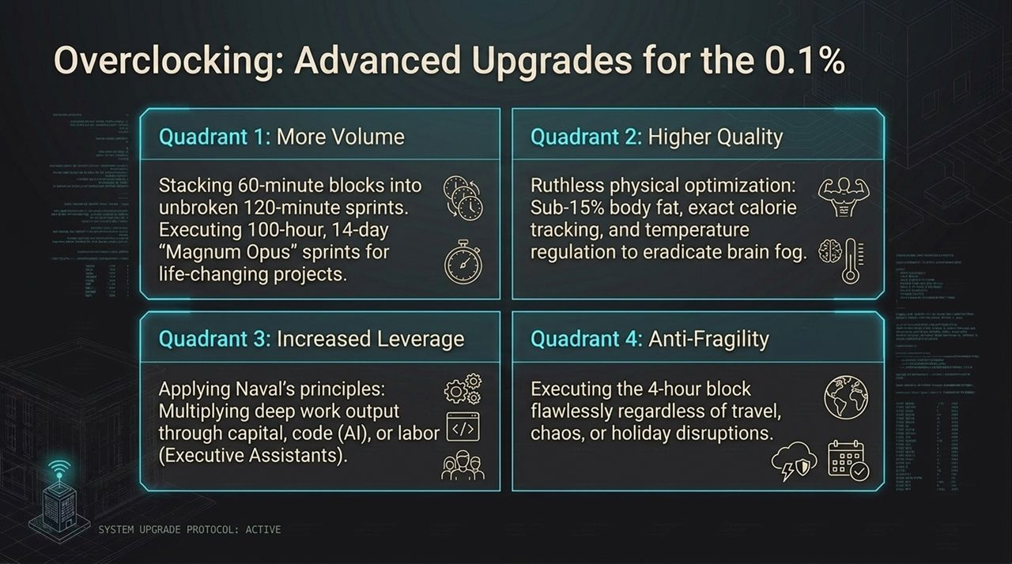
Notes:
Once you master the basic 4-hour daily execution loop, you can begin overclocking across four quadrants:
Q1 (Volume): Expand 60-minute blocks into unbroken 120-minute sprints, or run 100-hour 'Magnum Opus' sprints over 14 days.
Q2 (Quality): Optimize your physiology—sub-15% body fat, strict nutrition, and heat regulation to eliminate brain fog.
Q3 (Leverage): Multiply output using code, AI tools, capital, and dedicated Executive Assistants.
Q4 (Anti-Fragility): Build the capacity to hit your 4-hour deep work goal anywhere—whether traveling, during disruptions, or on holidays.

Slide 15
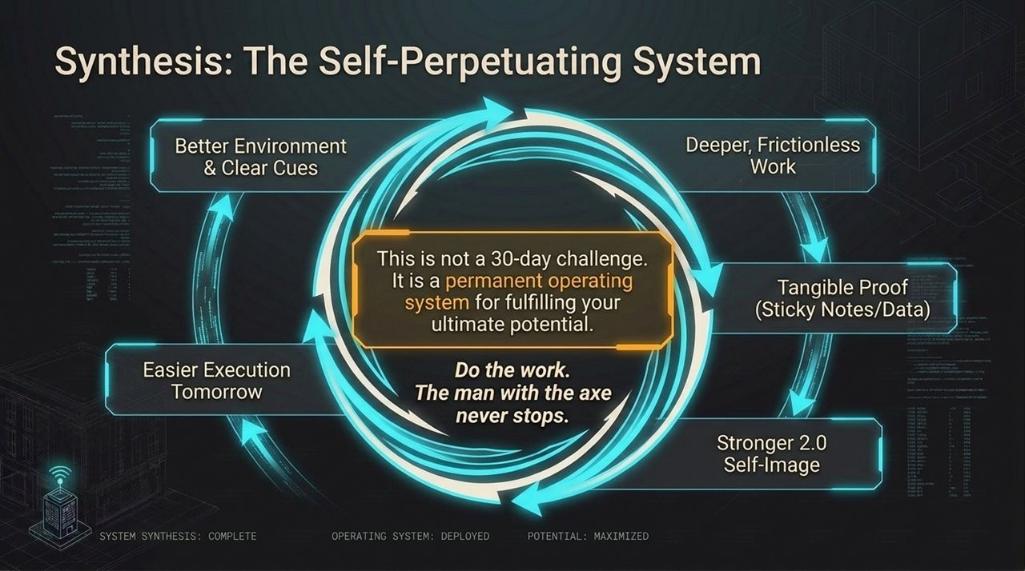
Notes:
This entire framework operates as a self-perpetuating flywheel.
A better environment leads to frictionless deep work. Deep work generates tangible proof (sticky notes, metrics). Tangible proof reinforces your V2.0 self-image. A stronger self-image makes execution effortless tomorrow.
This is not a temporary 30-day productivity challenge—it is a permanent operating system for fulfilling your ultimate potential.

Slide 16
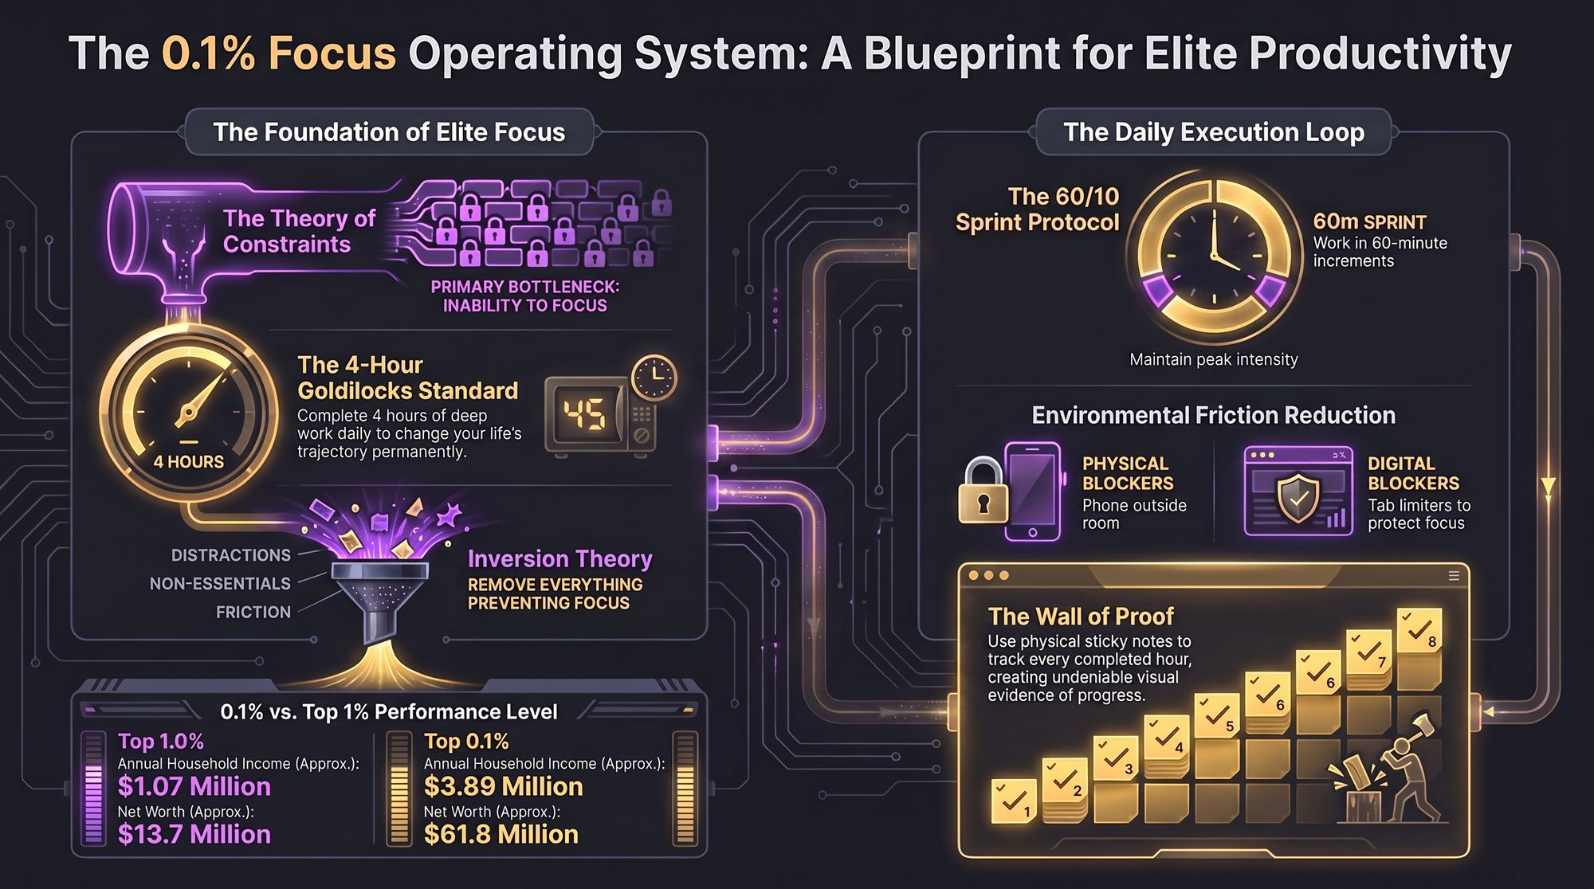
Notes:
To wrap up our breakdown, look at this complete architecture map.
It brings everything together: identifying your primary bottleneck using the Theory of Constraints, protecting the 4-Hour Goldilocks standard, executing 60/10 sprints, and eliminating digital and physical friction.
Execute this routine consistently, track your output, and let the results compound. Thank you.

